Slide 1




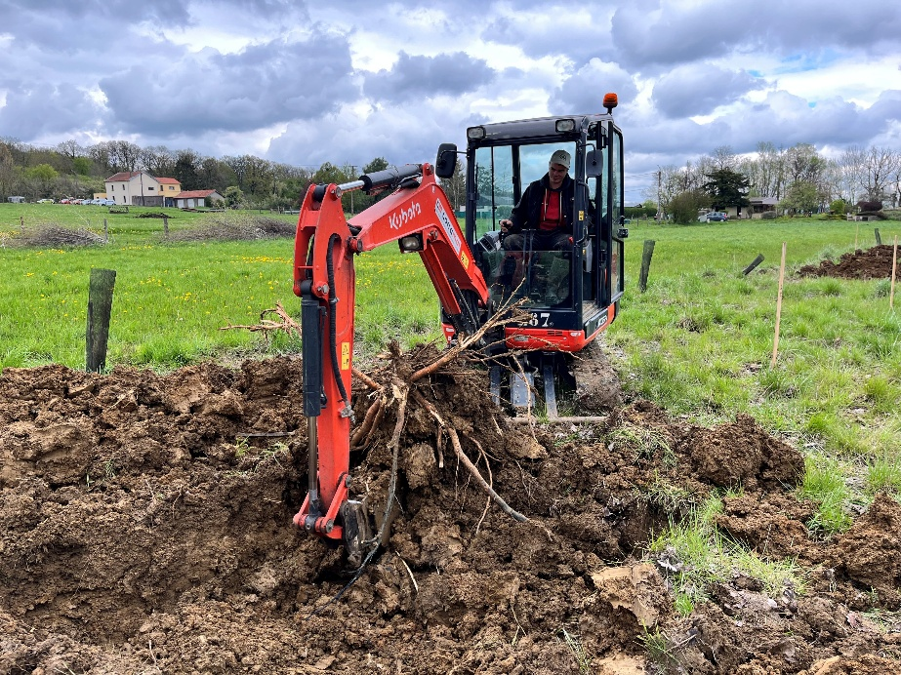
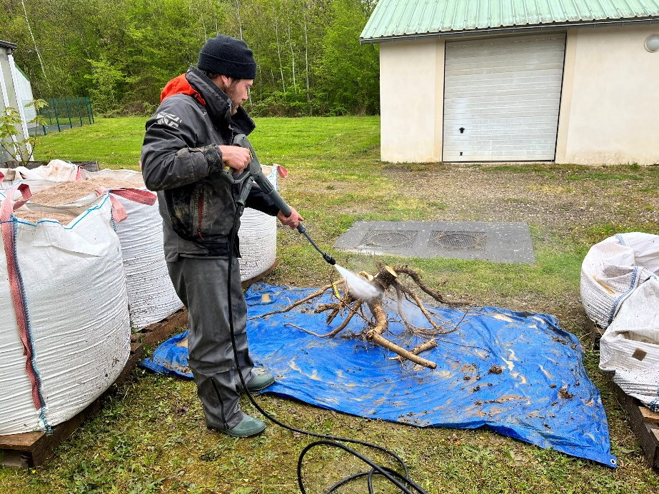
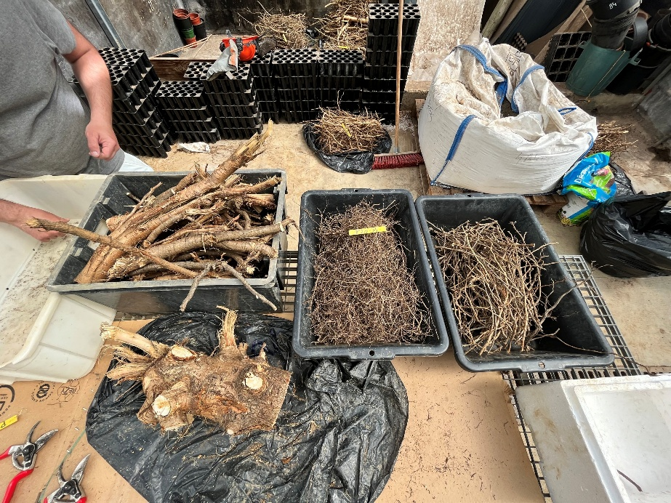

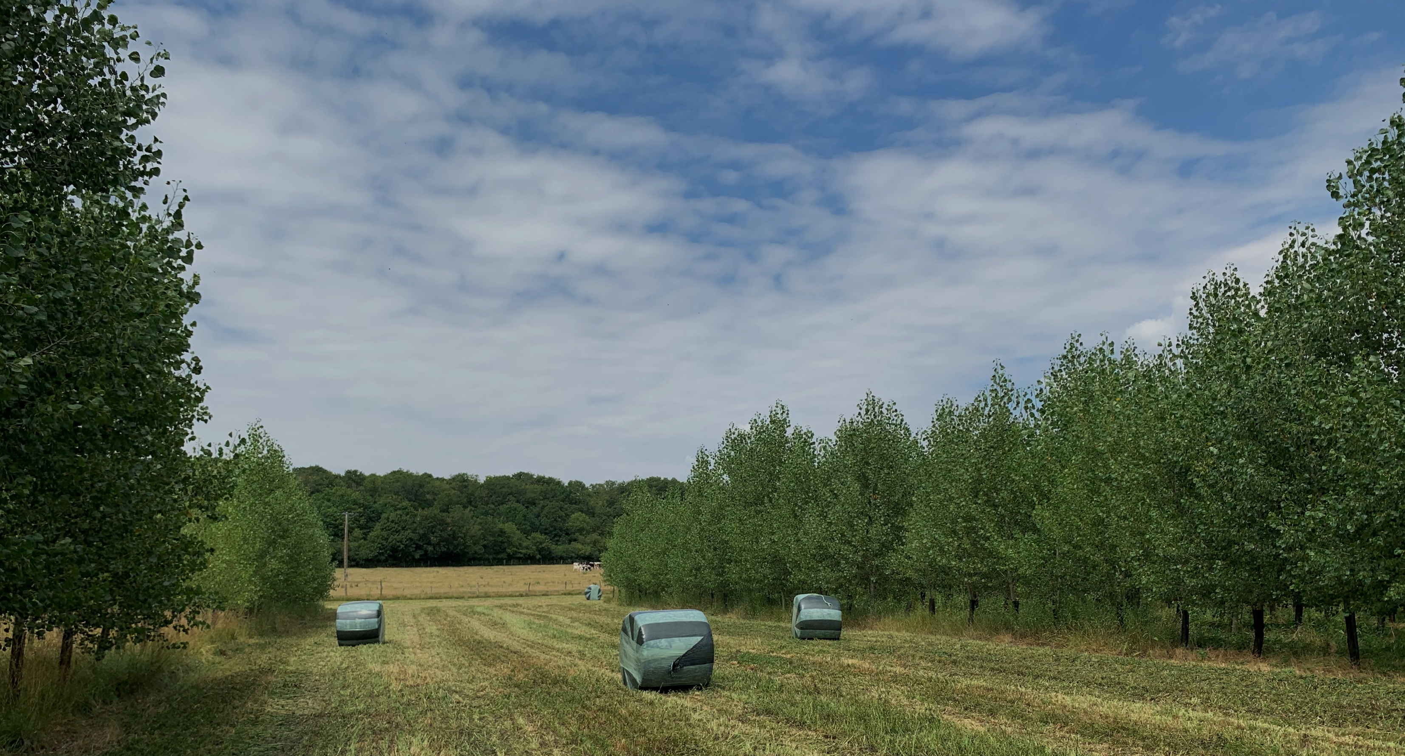
Biomass allocation to the root systems of trees in agroforestry
and forest mixture systems involving nitrogen-fixing species
Abdoulaye Ndiaye, Nicolas Marron, Erwin Dallé, Pierrick Priault
Université de Lorraine, AgroParisTech, INRAE, UMR Silva, 54500 Nancy, France
Introduction
Material and methods
Results
Forest plantations occupy only about 3% of the world’s land area but they supply more than one third of the global demand for wood products
Wood harvests in these plantations export large quantities of nitrogen (N) ↓ Use of herbaceous or woody N-fixing species
N inputs generally stimulate fine root growth and biomass allocation to aboveground parts
Our objective: To study the impact of intra- vs. inter-specific interactions on belowground biomass and N accumulation in a 10-year site in northeastern France
N concentrations with elemental analyzer
Calculation of the root / shoot biomass ratio (R/S), using allometric relationships to estimate shoot biomass
N concentration in poplar coarse roots higher in agroforestry then in monoculture (Fig. 4)
Fig. 2. Excavation of tree root systems, cleaning and sorting according to root categories
Material and methods
Results
Experimental site including (Fig. 1):
  Two agroforestry systems, (1) alder (Alnus glutinosa) associated to rye grass and fescue (Lolium perenne / Festuca ovina, (2) poplar (Populus deltoides × P. nigra) associated to a succession of clover (Trifolium pratense) and alfalfa (Medicago sativa),
  their equivalent crop and tree monocultures
  and a mixture of the two tree species (poplar / alder)
Root biomass characterization per category
Root biomass higher in poplar than in alder
No significant impact of treatments on root biomass of the two species (Fig. 3)
Fig. 4. N concentration (g/kg) per root category
Discussion
Poplar in agroforestry vs. monoculture: Facilitation expected and tree planting density twice lower in agroforestry
➔ Enrichment in N observed but no effect on root biomass
Alder in agroforestry vs. monoculture: Lower competition expected in agroforestry due to lower tree planting density
➔ No difference in root biomass
Forest mixture vs. monoculture: Root stratification and facilitation (benefiting poplar) expected
No difference in root biomass and N concentration
Perspectives: Study of the spatial distribution of roots in the different systems
Related references:
- Ndiaye et al. 2025. N₂-fixing species benefit biomass production in agroforestry mixtures depending on spatial scale and plantation age but not in the mixed forestry system. Forest Ecology and Management. 579: 122508.
- Ndiaye et al. Submitted. Biomass allocation to the root systems of trees in agroforestry and forest mixture systems involving nitrogen-fixing species. Agroforestry Systems.
Alder
Poplar
2m
Graminoids
Alfalfa / Clover
5m
2.5m
Fig. 1. Detail of block 1, repeated three times in the experimental trial
Fig. 3. Root biomass (kg) per category
Excavations of 18 stumps in April 2023: 1 tree per species, treatment (monoculture, agroforestry, forest mixture) and block. Depth: 70 cm / Area: 5 m²
Root sorting according to diameter (Fig. 2): fine (<2 mm), medium (2-5 mm), coarse (>5 mm), and drying at 50°C
Below- vs. above-ground biomass allocation
No difference in terms of the R/S ratio between species
or among treatments
Nitrogen concentration per root categories
N concentrations higher in alder than in poplar (Fig. 4)

